Slide 1

August 13, 2025

Slide 2
Commission Meeting August 13, 2025
Item 7
LAFCO Project No. 2025-3
SOI Update for Newcastle, Penryn, Placer Hills, and South Placer Fire Protection Districts.

Slide 3
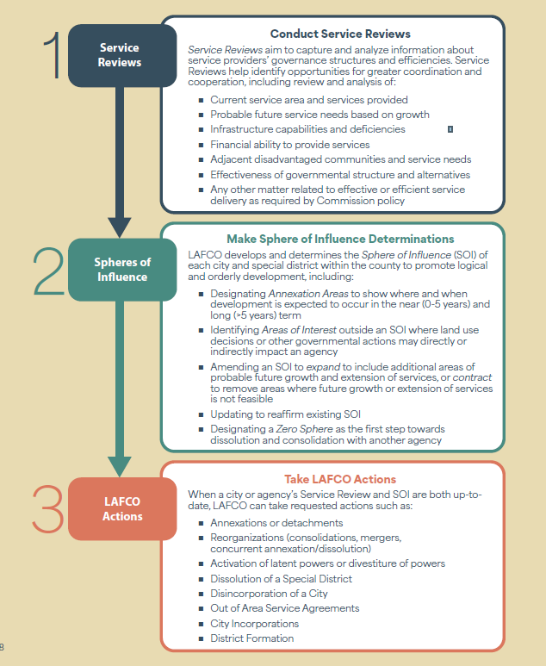
WHAT DOES LAFCO DO?:
LAFCO follows an ordered process with three steps

Slide 4
Item 7: Project No. 2025-03: Sphere of Influence Updates
The proposal before the Commission is to establish or update the Spheres of Influence for the Placer Hills, Newcastle, Penryn, and South Placer Fire Protection Districts in accordance with the findings of the recently adopted Municipal Service Review.
The SOI updates are required under statute and are part of LAFCO’s regular five-year cycle to ensure that service boundaries reflect current conditions and near-term planning needs.
Notes:
Good afternoon Chair Alpine and fellow Commissioners, My name is Marcus Mekhael, Senior Analyst with RSG. As you may be aware, RSG has been engaged by Placer LAFCO to assist with preparing the sphere of influence updates for the following four fire protection districts: Placer Hills, Newcastle, Penryn, and South Placer Fire Protection Districts as part of LAFCO’s ongoing five-year review cycle and consistent with the Commission’s adopted annual workplan.
These updates are informed by the findings of the recent Municipal Service Review adopted by the Commission on April 9, 2025 and are consistent with statute and local policy.
Specifically, these updates reflect the appropriate and near-term service boundaries for each district, based on current conditions, capacity, and local planning priorities and or follow proposed reorganization options as detailed in the MSR.
As we’ll see in the upcoming slides, each recommendation addresses a different service context, ranging from coterminous alignment to adopting a no SOI designation.

Slide 5
Project Milestones
April 9, 2025 – Commission adopts the Municipal Service Review (MSR) for Placer Hills, Newcastle, Penryn, and South Placer Fire Protection Districts
July 14, 2025 – Staff report on SOI updates prepared by RSG and LAFCO staff
August 13, 2025 – Public hearing scheduled for Commission consideration of SOI updates (LAFCO Project No. 2025-03)
Notes:
For background context, the Commission recently adopted the municipal service review – in April - involving the four fire protection districts subject to today’s SOI recommendations which include Placer Hills, Newcastle, Penryn, and South Placer Fire protection districts. It is typically the Commission’s practice to update the SOI for agencies in step with the municipal service review but for reasons staff can provide, was not done at the time of the MSR adoption. Therefore, RSG on behalf of staff, has come forward with the proposed SOI updates for the four fire districts which we will detail on the next few slides.

Slide 6
SOI Update Summary
Placer Hills FPD
Coterminous SOI
• Independent district providing fire protection, EMS, and community risk reduction • No previously established SOI on record • Recommended SOI: Coterminous with existing boundary • Reflects existing jurisdiction and service footprint; no anticipated expansion; meets baseline planning needs
Notes:
To RSG’s knowledge, Placer LAFCO has not previously adopted a Sphere of Influence designation for Placer Hills Fire Protection District
As part of the SOI updates before you today, RSG on behalf of staff, propose establishing a coterminous SOI, which aligns with the district’s existing jurisdictional boundary.
This SOI designation accurately reflects the districts current service responsibilities for fire protection and emergency medical services, as verified in the April 2025 MSR.
And as detailed in the staff report before you today, while there is a reorganization application on file involving Placer Hills FPD, moving forward with a coterminous sphere, grants the Commission flexibility to amend the sphere later depending on the results of the reorganization application.
Likewise, adopting the coterminous sphere can help prevent precedent for any speculative SOI actions.
More importantly, the coterminous sphere designation maintains a logical boundary framework reflective of existing conditions . A map of the proposed sphere follows on the next slide.

Slide 7
Placer Hills FPD
Proposed SOI (Coterminous)
Notes:
As shown on the map, the proposed SOI designation for Placer Hills FPD is coterminous, making the SOI align with the District existing service area which spans 33.77 square miles and is bisected by Interstate 80.

Slide 8
SOI Update Summary
Newcastle FPD
Zero SOI
• Independent district with same core service functions as others • No previously established SOI on record • Recommended SOI: Zero • Indicates no expected future service expansion and supports long-term governance review; aligns with potential reorganization considerations
Notes:
LAFCO also has no record of an SOI for Newcastle FPD.
Staff proposes declining the adoption of a SOI (subsequently making it a zero SOI designation) based on long-term governance considerations.
Specifically adopting no sphere supports the anticipation of a future consolidation or reorganization with a neighboring fire district and is consistent with the Commission’s policy (c)(3).
The zero SOI designation does not immediately change operations but reflects that no expansion of boundary or service area is planned or supported.
A map of the district follows on the next slide.

Slide 9
Newcastle FPD
Proposed SOI (Zero SOI)
Notes:
As shown on this slide is a map of Newcastle FPD’s jurisdictional boundary, which reflects no SOI. The District boundary presently spans 15 square miles and is anchored by the South Placer FPD, to the south, Penryn FPD to the west and Placer County Service Area 28 to the east ; the district is also bisected by Interstate 80.

Slide 10
SOI Update Summary (Continued)
Penryn FPD
Reduced SOI
• Serves a mix of rural residential areas and territory overlapping with Town of Loomis • No previously established SOI on record • Recommended SOI: Reduced; excludes portion within Loomis • Aligns with actual service area and excludes territory under Loomis’ land use authority
Notes:
Penryn FPD’s existing jurisdiction includes a small area that overlaps with the Town of Loomis which will be reflected on the map in the next slide.
Staff recommends establishing a reduced SOI that aligns closely with the district’s jurisdiction, excluding the Loomis overlap.
This SOI designation is recommended to ensure Penryn FPD’s current and future service area creates logical boundaries and orderly growth. The Town of Loomis is nearly entirely serviced by the South Placer FPD.
Therefore, it is anticipated that South Placer FPD would reflect the most logical service provider to the area.
This recommendation is consistent with the findings of the MSR

Slide 11
Penryn FPD
Proposed SOI (Reduced SOI)
Notes:
As shown on the map, the proposed SOI designation for Penryn is largely consistent with its jurisdictional boundary, with the exception of removing the portion of territory lying to the southern end of the District boundary
This area lies within the Town of Loomis, and is comprised of 111 parcels, approximately a total of 121 acres in size
As noted earlier, the Town of Loomis is largely serviced by the South Placer FPD, therefore it is recommended this area be removed from the District’s SOI with the anticipation of a future detachment from the district boundary upon receipt of a completed change of organization application;
For additional context: the District’s existing service area/boundary spans 17.8 square miles and is anchored by the South Placer FPD to the south and Newcastle FPD to the north/east.

Slide 12
SOI Update Summary (Continued)
South Placer FPD
Expanded SOI
• Larger suburban service area with varied land uses; serves Loomis by contract • No previously established SOI on record • Recommended SOI: Expanded to include the Town of Loomis – excludes Sierra Bluffs community • Reflects true service pattern and jurisdictional expectation; excludes Sierra Bluffs due to lack of service commitment
Notes:
Staff is recommending expanding the District’s sphere to include the entire Town of Loomis to align with current and future service needs.
This is with the exception of the Sierra Bluffs community which is proposed to be excluded from the District’s Sphere
This correction addresses an oversight from Rocklin’s 1982 annexation of the Sierra Bluffs community, when the concurrent detachment from South Placer FPD was not formalized.
Therefore the proposed expansion of the District’s Sphere, with the exception of the Sierra Bluffs community, further supports the commission’s goal to establish boundaries and orderly growth, consistent with statue and LAFCO policy

Slide 13
South Placer FPD
Proposed SOI (Expanded SOI; Excluding Sierra Bluffs Community)
Notes:
As previously cited, the Sphere designation reflected on this map is expanded to include the Town of Loomis on the North, illustrated by the red dashed line on the top extending beyond the District’s jurisdictional boundary in green.
Additionally, the green region on the bottom portion encompasses the Sierra Bluffs community, which is comprised of 136 parcels, approximately 64 acres in size. This is now illustrated to be excluded from South Placer’s Sphere.
The District/s existing service area spans approx. 42.1 square miles and located mostly east of Interstate 80 and is situated where Placer County and El Dorado county meet.

Slide 14
LAFCO Considerations
Service Review: Government Code Section 56430 requires LAFCO to prepare service reviews to inform the required review and updates to all agencies’ spheres of influence.
SOI Determinations: Government Code Section 56452(e) requires consideration of five determinations:
The present and planned land uses in the area, including agriculture and open space
The present and probable need for public facilities and services in the area
Notes:
These slides outline the five Sphere of Influence determinations required under Government Code Section 56425(e), which notably include attesting to the present and planned land uses in the District’s sphere, as well as any current and future need for any public facilities and services
And on the the following slide the rest of the determinations are detailed

Slide 15
LAFCO Considerations (Continued)
SOI Determinations (Continued)
The present and planned capacity of public facilities and adequacy of public services that the agency provides or is authorized to provide.
The existence of any social or economic communities of interest in the area if the commission determines that they are relevant to the agency.
The present and probable need for those public facilities and services of any disadvantaged unincorporated communities within the existing sphere of influence
Notes:
The required SOI determinations also serve to confirm the present and planned capacity of the agency's facilities and the adequacy of their services.
The staff report before you today includes all required SOI determinations which are largely informed by the findings of the 2025 Municipal Service Review – these have been provided as Attachment 1.

Slide 16
LAFCO Considerations (Continued)
Placer LAFCO Policies
The following policies guided staff’s recommendations for this SOI update:
Policy B(1): Encourage coterminous SOIs for agencies serving the same community.
Policy C(3): Assign zero SOIs to districts identified for potential dissolution, merger, or consolidation.
Policy C(6): Encourage agencies to evaluate opportunities for reorganization.
Policy III-B(5): Limit SOIs to areas that may reasonably benefit from district services based on adopted plans.
Notes:
There are a number of Commission policies that guide sphere of influence decisions. The proposed Sphere of Influence update for each of the discussed Placer County FPDs is necessary and conforms with relevant LAFCO policies as detailed on this slide.
Specifically, the proposed coterminous SOI for Placer Hills FPD aligns with the Commission’s policy preference to establish coterminous SOIs whenever possible.
Additionally, declining to adopt a SOI for Newcastle, therefore assigning a zero Sphere, aligns with the Commissions policy c3 which suggests zero spheres anticipate future reorganization/consolidations of districts, in which it is expected Newcastle will reorganize or consolidate with a neighboring fire agency.

Slide 17
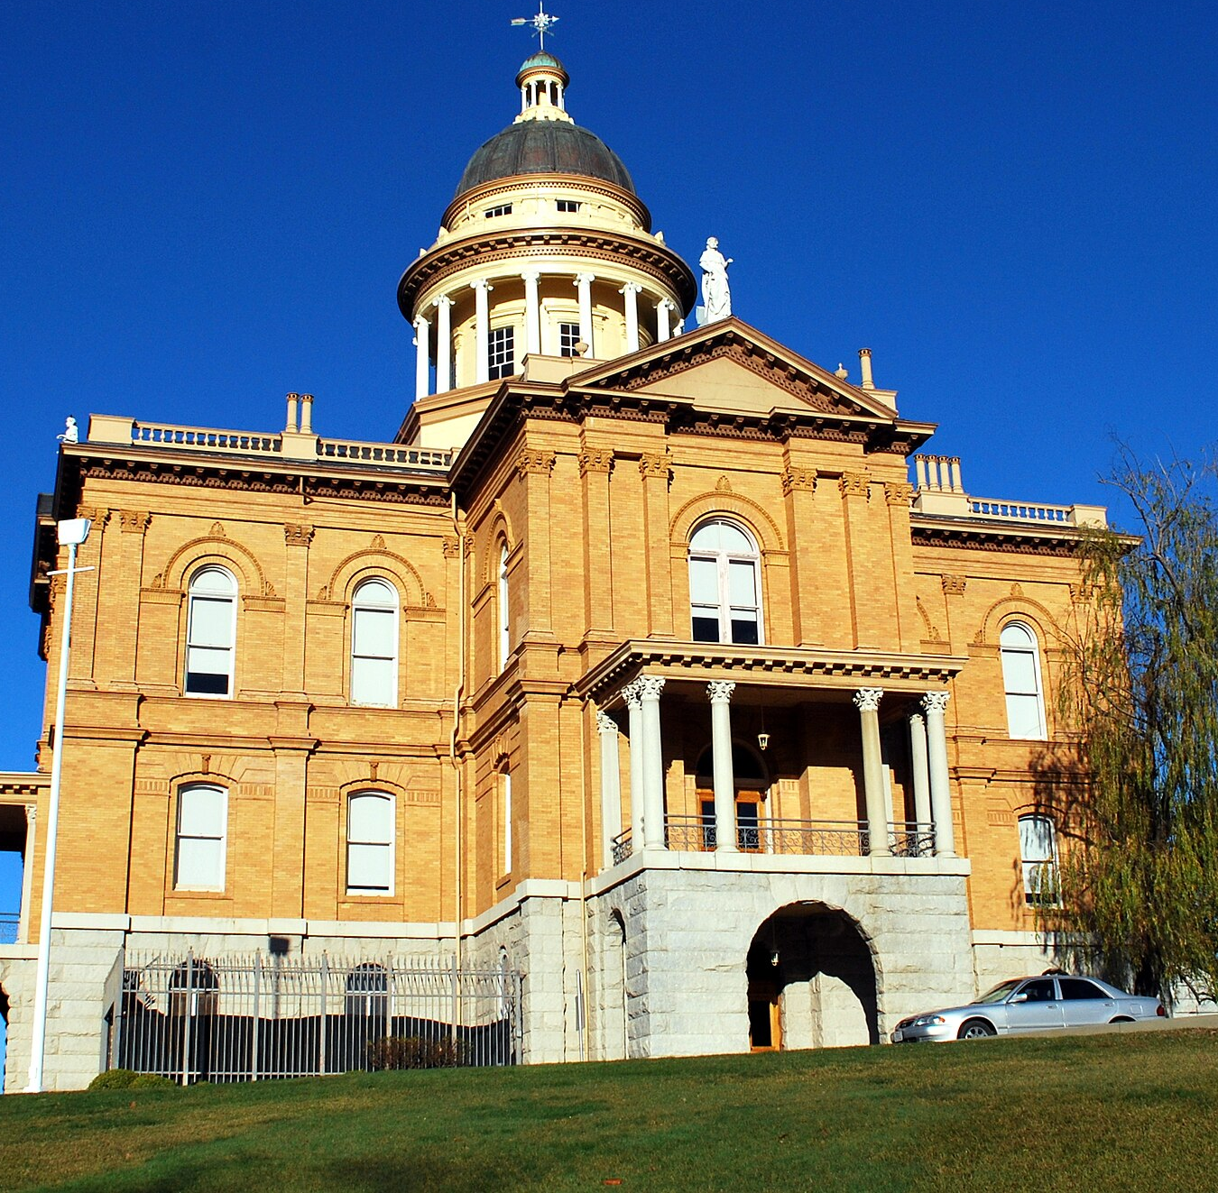
Environmental Review
LAFCO serves as the lead agency under CEQA
RECOMMENDATION
Staff recommends the Commission find these actions a “project” under CEQA but exempt from further review under State Guidelines 15061(b)(3)
Notes:
With respect to statisfying the Commission task under CEQA, LAFCO serves as the lead agency under CEQA for this Sphere of Influence amendment and staff is recommending that the Commission find these actions are a “project” under CEQA but exempt from further review under State Guidelines 15061(b)(3).
Staff believes this exemption appropriate given that spheres are planning policies and associated actions which do not change the environment or authorize any new uses or services.

Slide 18
Staff Recommendation
Adopt Resolution No. 25-10 Updating the Sphere of Influence for the following Fire Protection Districts:
Placer Hills FPD (Coterminous)
Newcastle FPD (Zero SOI)
Penryn FPD (Reduced SOI)
South Placer FPD (Expanded, excluding Sierra Bluffs)
This action is subject to a 30-day reconsideration period.
The action is exempt from CEQA pursuant to State Guidelines §15061(b)(3) and the “general rule” exemption, as the update constitutes a planning-level policy determination with no direct or indirect environmental impacts and does not authorize new services or development.
Notes:
To wrap up today’s presentation, RSG – in coordination with LAFCO staff - recommends that the Commission adopt Resolution No. 25-10, which updates the Spheres of Influence for four fire protection districts based on the findings of the recently adopted Municipal Service Review.
The proposed SOI actions are as follows: – Placer Hills FPD: Coterminous with existing boundary – Newcastle FPD: Zero SOI, indicating no anticipated future expansion – Penryn FPD: Reduced SOI to exclude the portion overlapping with the Town of Loomis – South Placer FPD: Expanded SOI to include the Town of Loomis, while excluding the Sierra Bluffs community
As a friendly reminder to the commission the proposed actions are subject to a 30-day reconsideration period, during which time affected parties may submit written requests for reconsideration.
As part of the recommendations, and as noted, earlier, Staff is making the determination that the proposed SOI updates are exempt under CEQA, pursuant to Guidelines Section 15061(b)(3)
On that note, we conclude the presentation and turn it back to your Chair Alpine for any questions or comments from the Commission. Thank you.

Slide 19
Item 8A: Fiscal Study to Evaluate the Consolidation Options for the South Placer Fire Protection District (FPD), Newcastle FPD, and Penryn FPD
Summary
Authorize Ridgeline Municipal Strategies to conduct a fiscal study to evaluate the financial feasibility of the following consolidation options:
Annexation of Newcastle Fire Protection District (FPD) into South Placer FPD;
Annexation of Penryn FPD into South Placer FPD; and
Annexation of Newcastle and Penryn FPDs into South Placer FPD.

Slide 20
Item 8A: Fiscal Study to Evaluate the Consolidation Options for the South Placer Fire Protection District (FPD), Newcastle FPD, and Penryn FPD
Background
Ridgeline Municipal Strategies completed the Placer Hills Fire Protection District and Newcastle Fire Protection District Consolidation Fiscal Study, evaluating the financial feasibility of consolidating Newcastle FPD and Placer Hills FPD on June 4, 2025.
Separately, on July 31, 2025, South Placer FPD submitted a letter requesting that LAFCO expand its fiscal review to include the additional consolidation options
Notes:
Village 5A annexation to the City of Lincoln – LAFCO Project No. 2024-02
Approved on December 4, 2024.

Slide 21
Item 8A: Fiscal Study to Evaluate the Consolidation Options for the South Placer Fire Protection District (FPD), Newcastle FPD, and Penryn FPD
Discussion
The proposed fiscal study aligns with LAFCO’s statutory mandate to promote efficient and logical service boundaries (§56001, §56301) and to explore alternative governance structures (§56668).
The request also echoes recommendations from the 2025 Fire Service Review, which proposed multiple potential consolidation options involving these agencies.

Slide 22
Item 8A: Fiscal Study to Evaluate the Consolidation Options for the South Placer Fire Protection District (FPD), Newcastle FPD, and Penryn FPD
Cost
The supplemental study is estimated to cost $37,745
Because the study will benefit the entire Western Placer County Region, staff believes it is appropriate for LAFCO to cover the cost.

Slide 23
Item 8A: Fiscal Study to Evaluate the Consolidation Options for the South Placer Fire Protection District (FPD), Newcastle FPD, and Penryn FPD
Staff Recommendation:
Authorize the Executive Officer to enter into an agreement with Ridgeline Municipal Strategies to conduct a supplemental regional fiscal and operational analysis evaluating the feasibility of the following reorganization options:
Annexation of Newcastle Fire Protection District (FPD) into South Placer FPD;
Annexation of Penryn FPD into South Placer FPD; and
Annexation of Newcastle and Penryn FPD into South Placer FPD.
Direct that the supplemental study include consideration of South Placer FPD’s ability to provide both fire protection and emergency transport services as a factor in the regional analysis.
Approve funding of the estimated $37,745 from LAFCO’s budget, acknowledging that the study benefits the wider Western Placer County region and will provide an objective, data-driven foundation for assessing long-term service delivery and governance options.
Notes:
30-day reconsideration and 35-day challenge period for CEQA

