Slide 1

MSR and SOI Update
Public Cemetery Districts in Placer County
Administrative Draft
Placer LAFCO
June 10, 2026

Slide 2
Overview
Purpose of a Municipal Service Review (“MSR”)
Agencies Covered:
  Auburn Cemetery District
  Colfax Cemetery District
  Newcastle, Rocklin, and Golden Hill Cemetery District (“NRG”)
  Placer County Cemetery District 1
  Roseville Cemetery District
  Tahoe City Cemetery District

Slide 3
Project Timeline and Milestones
LAFCO retained RSG in October 2024 to prepare this MSR and SOI Update
  November 2024: Data collection began
  January 2025: RSG interviewed District staff
  April 2025: RSG conducted an on-site visit to the District
  July 2025: Technical Draft circulated to LAFCO and District staff
  August 2025: Revised Draft circulated to LAFCO staff
  May 2026: Technical Draft circulated for second round of courtesy reviews to District Staff
  June 2026: Public Hearing for Admin Draft

Slide 4
Cemetery Districts’ Background

Slide 5
Overview
Category | Auburn Cemetery District | Colfax Cemetery District | Cemetery District 1 | NRG Cemetery District | Roseville Cemetery District | Tahoe City Cemetery District
Formation | 1935 | 1925 | 1917 | 1927 | 1939 | 1965
Size (sq miles) | 91.03 | 157.61 | 39.53 | 89.68 | 110.72 | 169.54
Services Provided | Pre-Planning, Casket Burial, Cremation Burial, Niches, and Ossuary services. | Casket Burial, Cremation Burials | Burial Plots, Cremation Niches | Burials, Niches | Caskets, Cremation, Niches | Burial Plots, Cremation Niches
Service Population | 45,087 | 9,189 | 61,359 | 71,749 | 217,178 | 5,948

Slide 6
Regional Map

Slide 7
Government Code Section 56425 & 56430
SOI Determinations
Present and Planned Land Uses
Present and Probable Need for Facilities and Services
Present Capacity of Public Facilities and Adequacy of Public Services
Existence of any Social or Economic Communities of Interest
Present and Probable Need for Facilities and Services by and DUCs in Existing SOI
MSR Determinations
Growth, Population, and Housing
Disadvantaged Unincorporated Communities
Capacity of Facilities and Adequacy of Services
Financial Ability to Provide Services
Opportunities for Shared Services
Accountability

Slide 8
SOI Determinations

Slide 9
1. Present and Planned Land Uses
  Lands within Cemetery Districts primarily consists of residential and agricultural uses. While majority of unincorporated lands are vacant.
  2. Present and Probable Need for Facilities and Services
  The proposed SOIs for each cemetery district demarks current and/or probable future service needs
3. Present Capacity of Public Facilities and Adequacy of Public Services
  Each cemetery district has sufficient capacity and adequate infrastructure and facilities to provide cemetery services.
  4. Existence of any Social or Economic Communities of Interest
  Each cemetery district’s proposed SOI reflects existing and relevant social/economic communities of interest
  5. Present and Probable Need for Facilities and Services by and DUCs in Existing SOI
  6 DUCs exist within or contiguous to cemetery districts proposed/existing SOIs but no cemetery service deficiencies identified

Slide 10
MSR Determinations

Slide 11
Category | Determination
Growth, Population, and Housing | Limited growth is expected within the Districts’ boundaries
Capacity of Facilities and Adequacy of Services | While some cemetery sites have reached capacity, all Districts have adequate capacity to accommodate existing and future residents

Slide 12
Category | Determination
Financial Ability to Provide Services | Nearly all Districts maintained a good financial position over the report period RSG was unable to assess the net position of Colfax & Tahoe due to lack of available audits Funded pension obligations should be monitored
Status of, and opportunities for, shared facilities | Colfax & Tahoe contract with other entities to perform administrative services – no other opportunities were identified.

Slide 13
Category | Determination
Accountability for Community Service Needs | Colfax & Tahoe do not hold regular meetings in accordance with their principal act Tahoe does not currently employ professional staff to manage the day-to-day operations and business

Slide 14
Proposed SOI Updates

Slide 15
Summary
District | Existing SOI Designation | Proposed SOI Update
Auburn Cemetery District | Coterminous | Expand SOI to align with City of Auburn
Colfax Cemetery District | No SOI adopted | Establish provisional coterminous SOI
Newcastle, Rockling, Golden Hill Cemetery District | Unknown | Expand SOI to align with City of Rocklin
Placer County Cemetery District 1 | Unknown | Expand SOI to align with City of Lincoln
Roseville Cemetery District | No SOI adopted | Expand SOI to align with City of Roseville; reduce SOI for portion within the City of Rocklin
Tahoe City Cemetery District | Unknown | Establish coterminous SOI

Slide 16
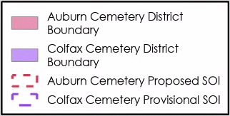
Auburn Cemetery District, Colfax Cemetery District

Slide 17
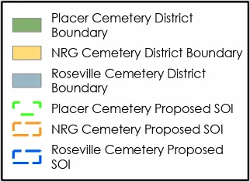
Newcastle, Rocklin, and Gold Hill Cemetery District, Placer Cemetery District 1, Roseville Cemetery District

Slide 18
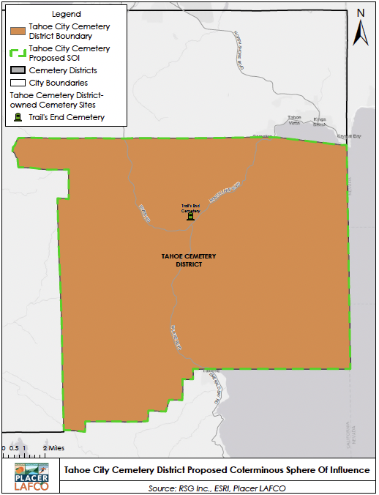
Tahoe City Cemetery District

Slide 19
Potential Future Boundary Adjustments

Slide 20
Overview
Area | Current Condition | Future Boundary Consideration
City of Auburn | NRG Cemetery District overlap | Transition territory into Auburn Cemetery District
City of Lincoln | NRG Cemetery District overlap | Transition territory into Placer Cemetery District #1
City of Rocklin | Roseville Cemetery District overlap | Transition territory into NRG Cemetery District
City of Roseville | NRG Cemetery District overlap | Transition territory into Roseville Cemetery District
Granite Bay Community | Dual service areas between NRG and Roseville Cemetery Districts | Additional analyses recommended

Slide 21
Area | Future Boundary Consideration
City of Auburn (Area 1) | Transition territory into Auburn Cemetery District
City of Lincoln (Area 2) | Transition territory into Placer Cemetery District #1
City of Rocklin (Area 3) | Transition territory into NRG Cemetery District
City of Roseville (Area 4) | Transition territory into Roseville Cemetery District
Granite Bay Community (Area 5) | Additional analyses recommended

Slide 22
Additional Governance Recommendations

Slide 23
Summary
Agency | MSR Recommendation
Colfax and Tahoe Cemetery Districts | Ensure agencies conduct regular meetings Ensure sufficient staffing levels are maintained and/or explore shared service arrangements with neighboring providers LAFCO to check in with agencies every 6 months over next year

Slide 24
LAFCO Staff’s Recommendation
  Receive the draft MSR and SOI Update for the six cemetery districts in Placer County
  Provide any initial comments or direction
  Open a 45-day public review and comment period; and
  Set a hearing for the August 12, 2026 meeting to consider the final MSR and SOI Update, (including any revisions resulting from public and agency comments, for action)

Slide 25
Carol Ieromnimon, Associate
RSG
cieromnimon@rsgsolutions.com
714.316.2197
Kendall Schroth, Analyst
RSG
kschroth@rsgsolutions.com
714.516.8180

