Slide 1

LAFCo’s 3 “S”
Sphere Updates
Service Reviews
Special Studies
Understanding when each should be done
Jason Fried, Executive Officer
Amanda Ross, Acting Assistant Executive Officer
September 9, 2026

Slide 2
Agenda
List of all the initials used
What is a Sphere of Influence
What is a Service Review
What is a Special Study
Dive into the Service Review World
Balance of Workload
Questions
Notes:
Jason

Slide 3
Alphabet Soup
CKH – Cortese-Knox-Hertzberg Local Government Reorganization Act of 2000
DUC – Disadvantage Unincorporated Communities
LAFCo – Local Agency Formation Commission
JPA – Joint Power Authority; Joint Power Agency
MSR – Municipal Service Review (aka Service Review)
SOI – Sphere of Influence
Notes:
Jason

Slide 4
What is a Sphere of Influence?
Mentioned over 90 times in CKH
56076. "Sphere of influence" means a plan for the probable physical boundaries and service area of a local agency, as determined by the commission.
56425. (g) On or before January 1, 2008, and every five years thereafter, the commission shall, as necessary, review and update each sphere of influence.
56430. (a) In order to prepare and to update spheres of influence in accordance with Section 56425, the commission shall conduct a service review of the municipal services provided in the county or other appropriate area designated by the commission.
Notes:
Jason

Slide 5
What does this government mumbo jumbo mean?
Formally – What area the agency currently serves or may serve in the future.
Less Formal – Areas where development could impact how the agency provides services in the future, but where the agency may not annex but the development of the area can impact services.
An agencies SOI is the sole discretion of LAFCo.
Notes:
Jason

Slide 6
Different Types of SOI and What They Mean
Placer LAFCo Policy 1.2
Coterminous Sphere: A sphere of influence that is identical with the agency’s existing jurisdictional boundary. A coterminous sphere is applied when no future expansion is anticipated, or when concerns regarding service capacity or governance make boundary expansion inappropriate.
Expanded Sphere: A sphere of influence that extends beyond the agency’s current jurisdictional boundary. Expanded sphere’s identify areas that should be annexed into the agency in the foreseeable future, and generally align with adopted City and County General Plans or growth areas.
Reduced Sphere: A sphere of influence that excludes territory currently within the agency’s boundary. A reduced sphere is applied when portions of the agency’s jurisdiction are not receiving service, are better served by another provider, or should be detached in the future
Notes:
Amanda

Slide 7
Different Types of SOI and What They Mean
Placer LAFCo Policy 1.2
Zero Sphere: A sphere designation that removes the agency’s sphere entirely. A zero sphere signals that the agency’s service responsibilities should be reassigned to another local government, and that the agency should be dissolved in the future. Adoption of a zero sphere may lead the Commission to initiate reorganization or dissolution proceedings consistent with Government Code Sections 56375(a)(2) and 56375.1.
Phased (Primary and Secondary) Sphere: A sphere divided into near-term (primary) and long-term (secondary) service areas. The phased sphere provides a staged framework for growth and ensures expansion occurs only after capacity, infrastructure, or policy triggers are met.
Service-Specific Sphere: A sphere designation applied to territory within which only certain services of a multi-service district are anticipated to be provided. A service-specific sphere recognizes that not all services of an agency are needed within a given area, allowing for more precise alignment of service delivery responsibilities.
Notes:
Amanda

Slide 8
Different Types of SOI and What They Mean
Placer LAFCo Policy 1.2
Provisional Sphere: A temporary sphere designation applied to agencies experiencing financial or service related concerns. A provisional sphere acknowledges current deficiencies and identifies specific improvements that must be addressed within a defined timeframe. During this period, LAFCO monitors progress and may conduct a follow-up review to determine whether adequate corrective actions have been taken. If deficiencies remain unresolved, the Commission may consider modifying the designation to a zero sphere and initiating reorganization or dissolution proceedings consistent with Government Code Sections 56375(a)(2) and 56375.1.
Special Study Area or Area of Interest: Other options the Commission may consider include establishing a Special Study Area or Area of Interest. These areas would be flagged for further evaluation but not included in an adopted sphere of influence. A special study area or area of interest would be used when service responsibilities are unclear, or when LAFCO determines additional analysis is required before assigning sphere status to that area.
Notes:
Amanda

Slide 9
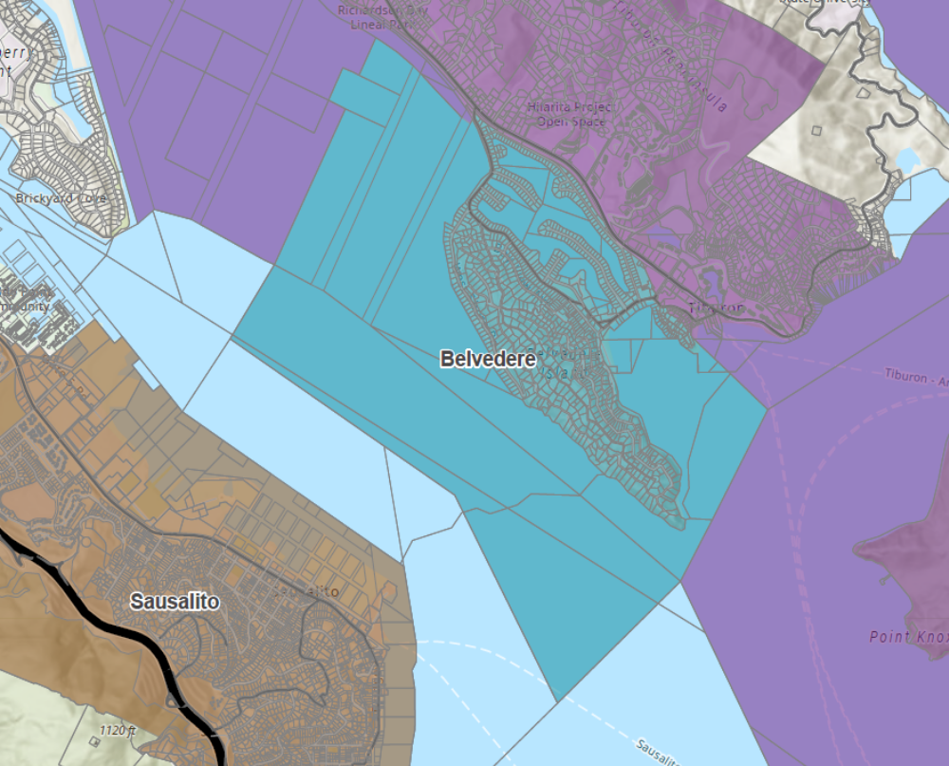
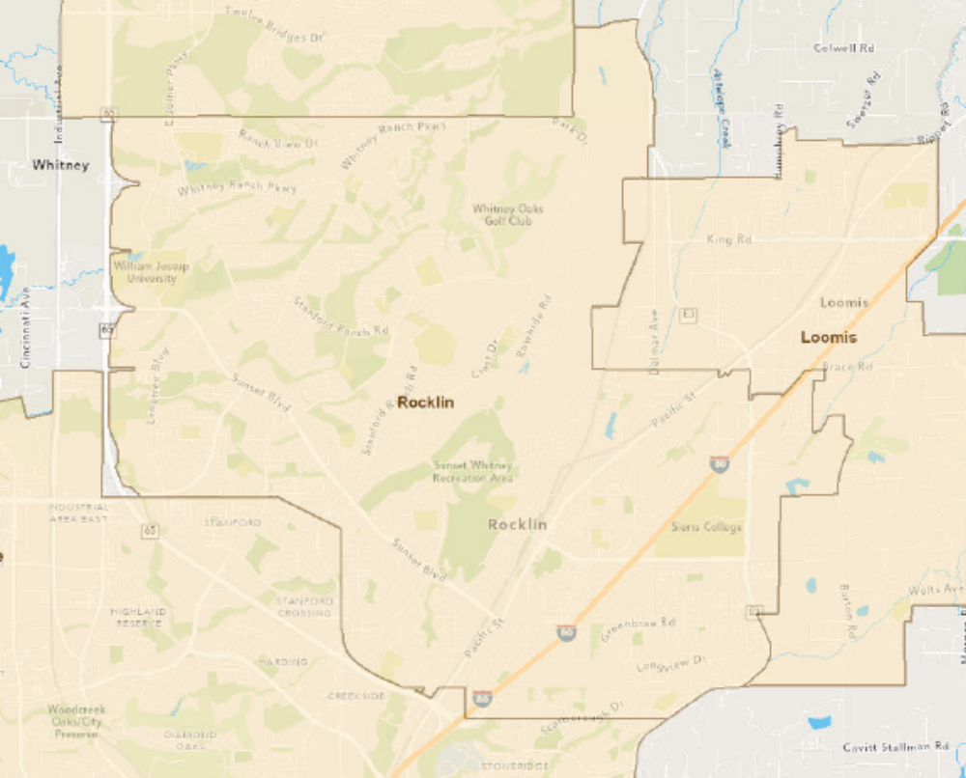

Is an SOI Update Needed - Real World Applications
Notes:
Jason

Slide 10
What is a Service Review?
Sometimes called a Municipal Service Review
All Service Reviews must answer the following 7 questions based on 56430 (a)
(1) Growth and population projections for the affected area.
(2) The location and characteristics of any disadvantaged unincorporated communities within or contiguous to the sphere of influence.
(3) Present and planned capacity of public facilities, adequacy of public services, and infrastructure needs or deficiencies including needs or deficiencies related to sewers, municipal and industrial water, and structural fire protection in any disadvantaged, unincorporated communities within or contiguous to the sphere of influence.
(4) Financial ability of agencies to provide services.
(5) Status of, and opportunities for, shared facilities.
(6) Accountability for community service needs, including governmental structure and operational efficiencies.
(7) Any other matter related to effective or efficient service delivery, as required by commission policy.
Notes:
Amanda

Slide 11
Great more government mumbo jumbo
Service reviews provide the necessary analysis to present determinations based on the seven factors. Generally, this equates to information pertaining to:
  Projected changes in population
  Disadvantaged Unincorporated Communities (DUCs) mapping and analysis
  Existing and future service adequacy, existing and future infrastructure needs or deficiencies; this includes those explicitly related to health and safety services of water, sewer, and fire in DUCs
  Fiscal health of the agency
  Agency coordination and collaboration of shared facilities with neighbors (if applicable)
  Governmental and operational efficiencies
  And anything else required by Commission policy
Notes:
Amanda

Slide 12
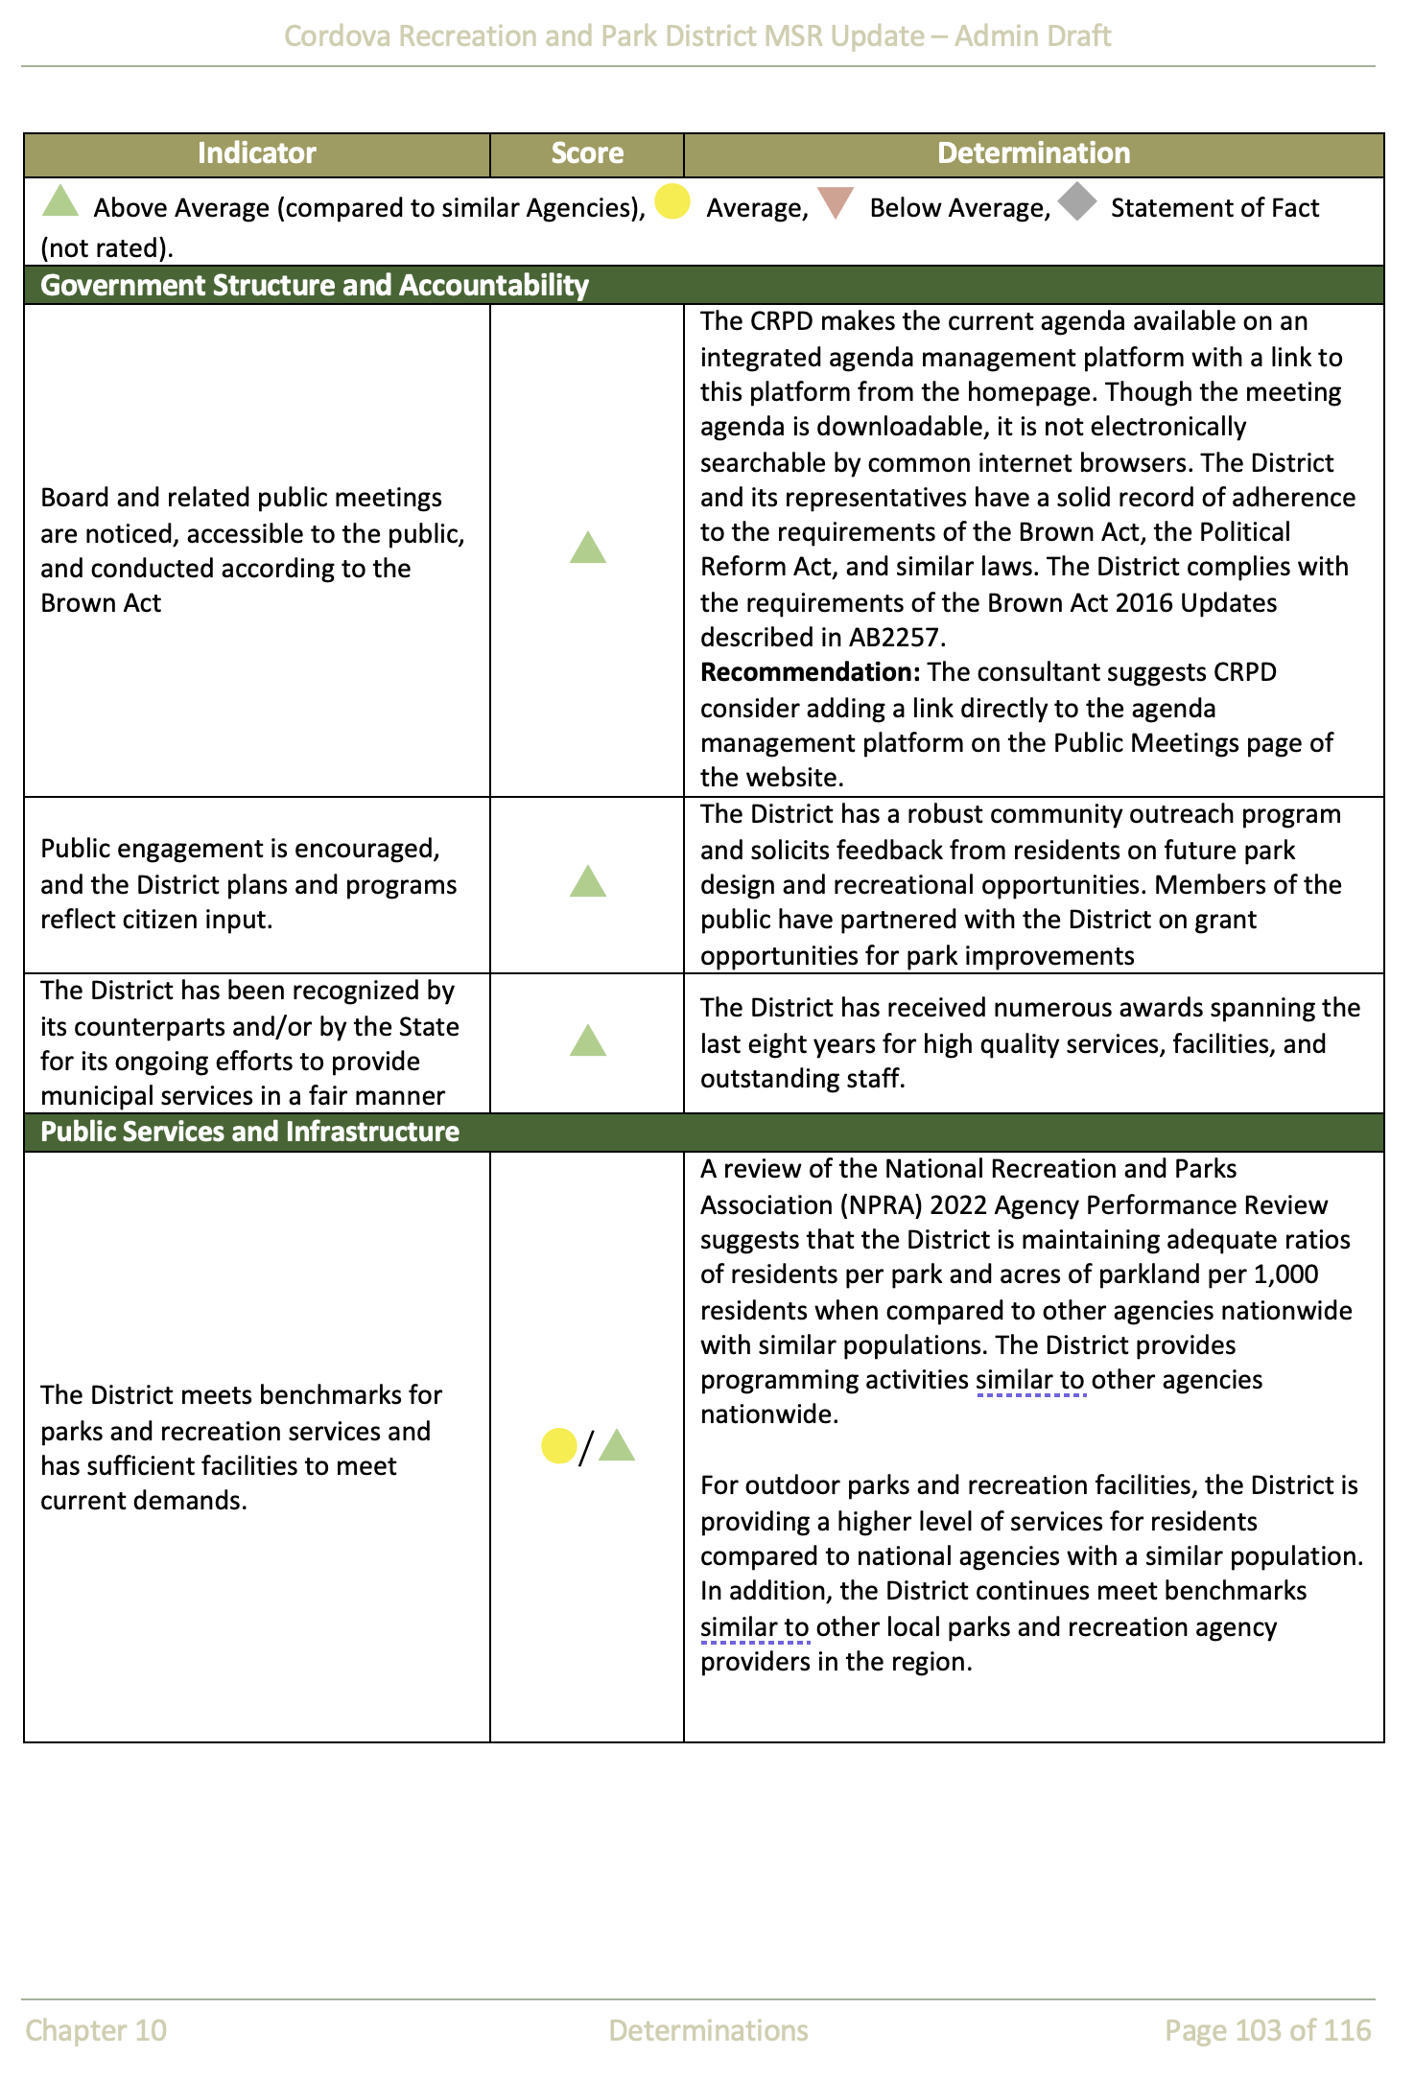
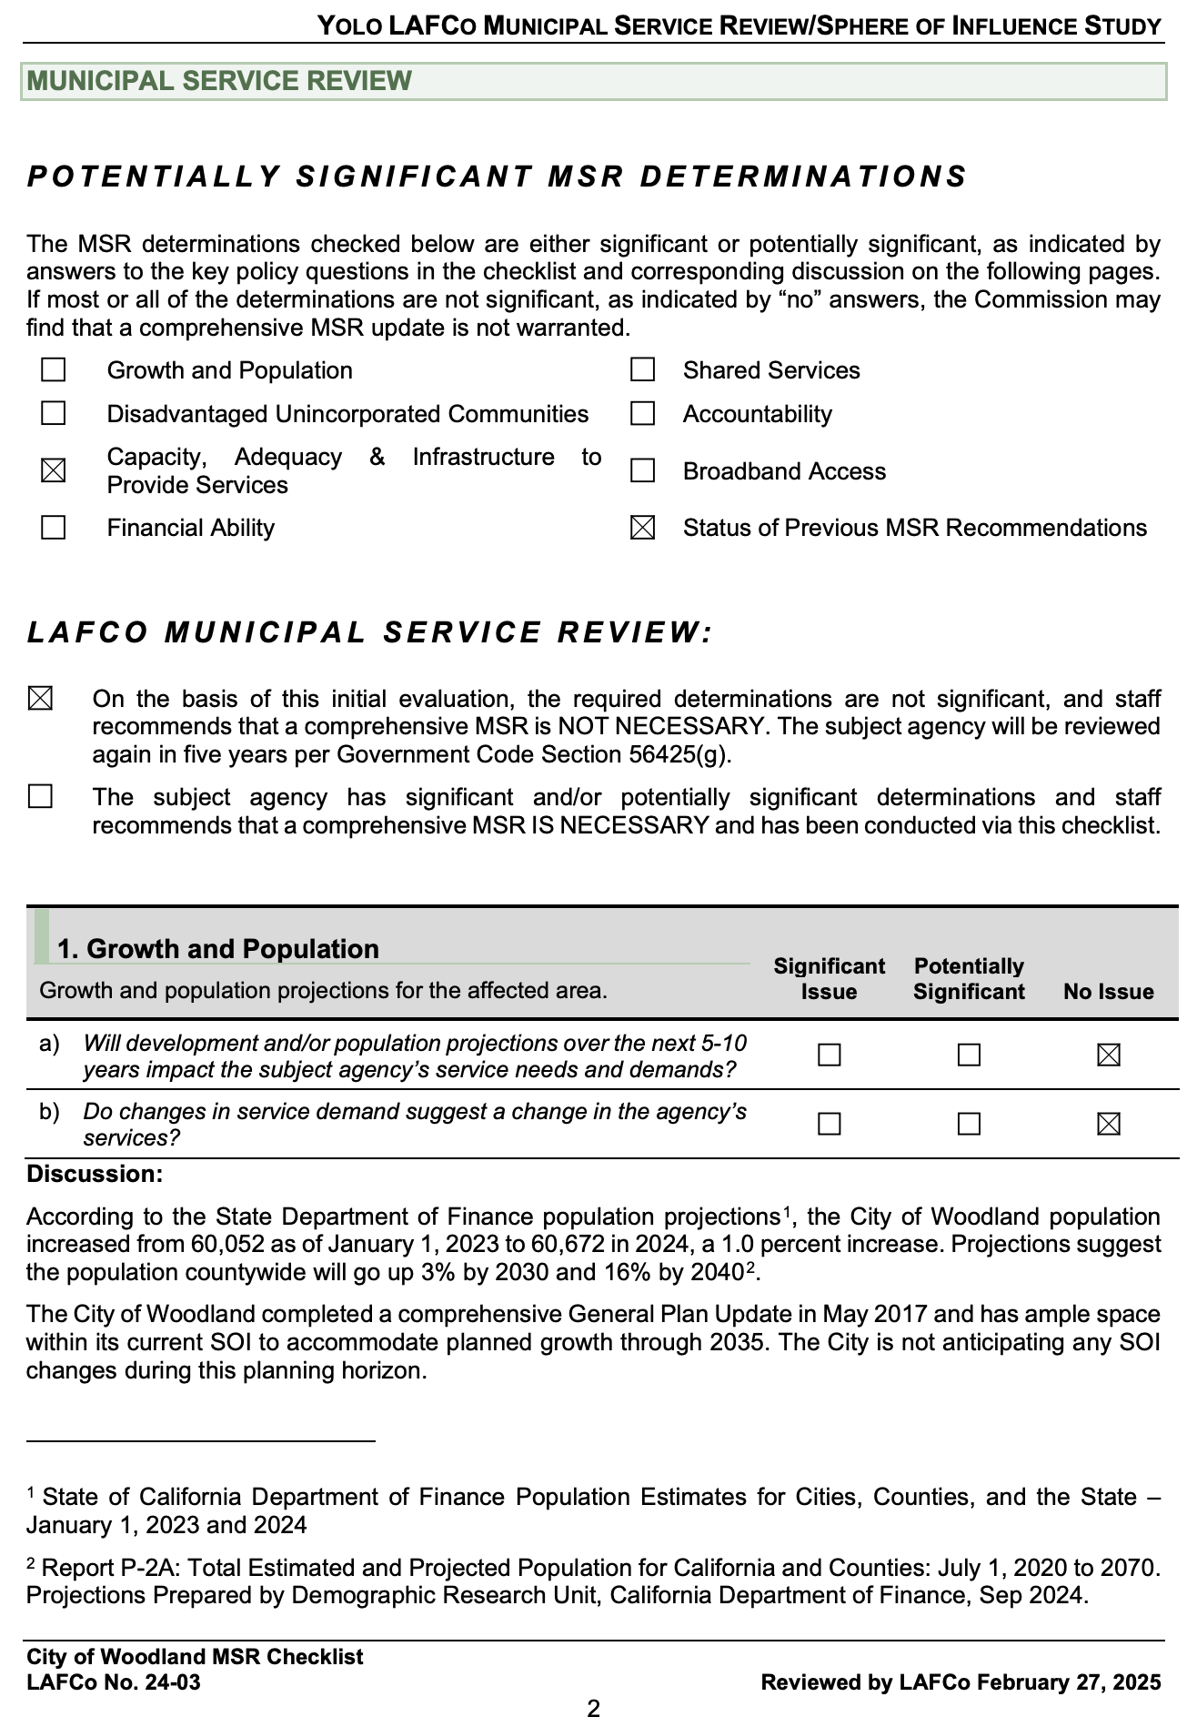
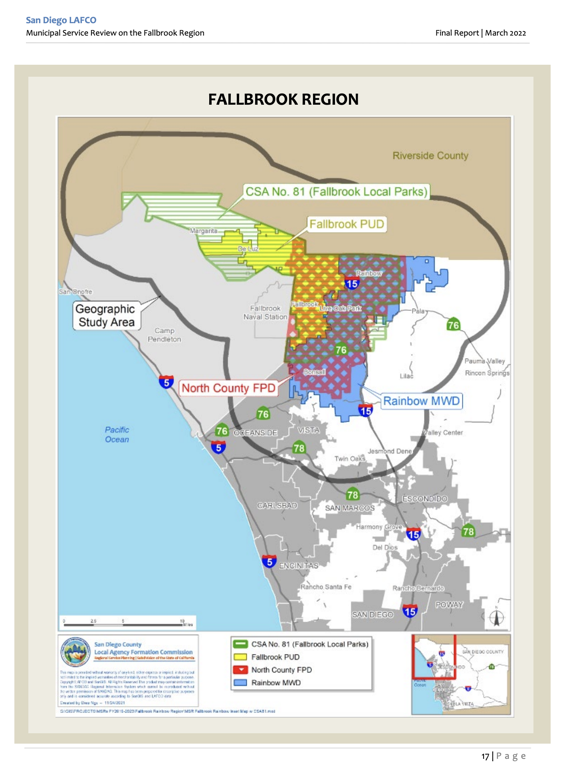
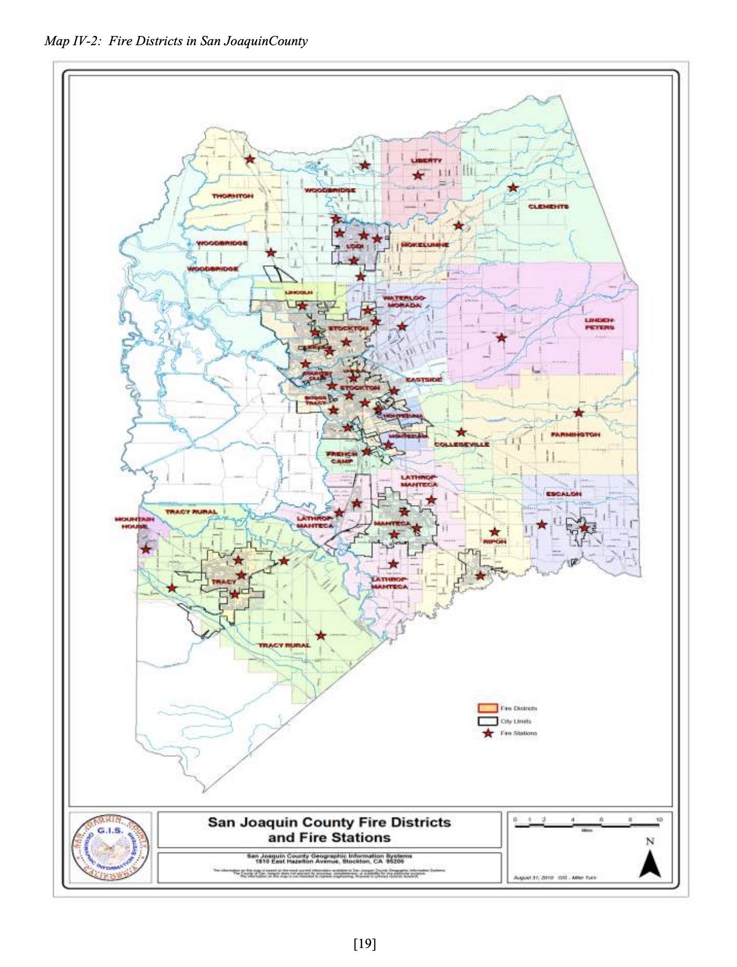
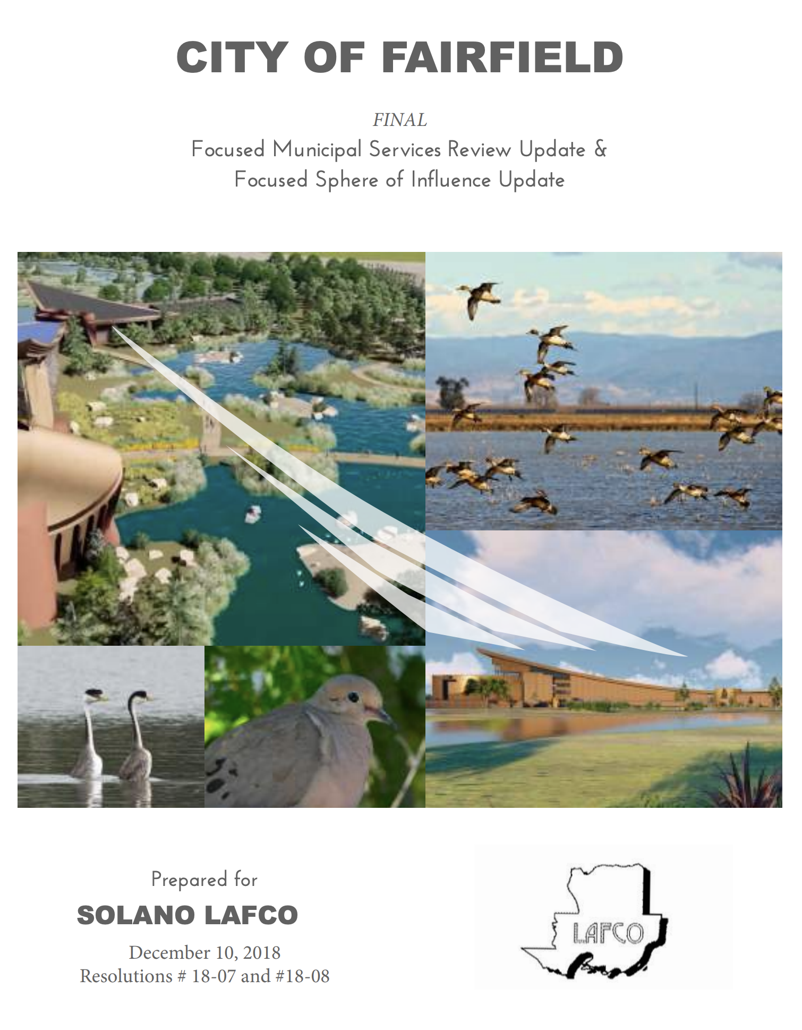
The same but different!
Notes:
Look Different:
Determinations – Cordova Recreation and Parks District – Sacramento LAFCO
City of Woodland MSR Checklist – Yolo LAFCO
Reviewed Different:
Regional review – San Diego LAFCO – public utility district, fire protection district, water district, county service area
All fire district – rural fire districts in San Joaquin County
Focused MSR/SOI – City of Fairfield update for the pacific flyway project
Regional – San Diego LAFCO
By service type – San Joaquin County LAFCO
Countywide -
Single agency
Consider what works best for your LAFCO

Slide 13
Are all Service Reviews the Same? (NO)
Styles – One agency at a time vs. review by region of different types of agencies vs. review of group of similar agencies
Depth of Review – High level review vs deep dive into each agency
Different types of review depending on agency and its functions
Agencies with issues that need to be addressed
Consultant lead vs. in-house
Notes:
Jason

Slide 14
Lucky - Who Gets a Service Review?
All LAFCo member cities and independent special districts
Other independent special districts such as mosquito abatement district
Some dependent special district such as:
  County service areas
  Open space districts
  Sewer management districts
  Others ????????
Unlucky - Who Doesn’t get a Service Review?
Counties
School districts
Others as defined by CKH
Notes:
Jason

Slide 15
Do JPAs get to have the fun of a Service Review?
NO – A JPA on its own does not fall under LAFCo justification to review for Service Review.
BUT – There may be cases where in order to do a proper service review for one or more of the member agencies to the JPA a service review of the JPA would need to occur as well.
Quiz Time - Which of these JPA’s should have LAFCo MSR preformed?
  Example 1 – sewer treatment plant is created through a JPA to do wastewater treatment for three agencies.
  Example 2 – special district and school district form a JPA to run programs for a local park.
  Example 3 – 2 cities form a JPA so they can run a shared fire department.
Notes:
Jason

Slide 16
Independent Special Districts Service Review Workplan
No. | Independent Special District | Adoption Date | Planned Service Review and Notes
1 | Auburn Recreation District | None | Needs to be scheduled
2 | Auburn Valley Community Services District | None | Needs to be scheduled
3 | Colfax Cemetery District | None | Admin Draft In Progress
4 | Newcastle, Rocklin, Gold Hill Cemetery District | None | Admin Draft In Progress
5 | Placer County Cemetery District 1 | None | Admin Draft In Progress
6 | Placer Mosquito Vector Control District | None | Needs to be scheduled
7 | Roseville Cemetery District | None | Admin Draft In Progress
8 | Suburban Pines Community Services District | None | Admin Draft In Progress
9 | Tahoe-Truckee Sanitation Agency | None | Needs to be scheduled
10 | Christian Valley Park Community Services District | 2006 | Needs to be scheduled
11 | Foresthill Public Utility District | 2006 | Planned for 2026-2027
12 | Heather Glen Community Services District | 2006 | Admin Draft In Progress
13 | Meadow Vista County Water District | 2006 | Admin Draft In Progress
14 | Midway Heights County Water District | 2006 | Admin Draft In Progress
15 | Placer County Resource Conservation District | 2006 | Needs to be scheduled
16 | Placer County Water Agency | 2006 | Needs to be scheduled
17 | Auburn Cemetery District | 2013 | Admin Draft In Progress
No. | Independent Special District | Adoption Date | Planned Service Review and Notes
18 | Alpine Springs County Water District | 2017 | Admin Draft In Progress: fire only
 |  |  | Full Agency MSR/SOI Needs to be scheduled
19 | Alta Fire Protection District | 2017 | Planned for 2026-2027
20 | Donner Summit Public Utility District | 2017 | Needs to be scheduled
21 | Foresthill Fire Protection District | 2017 | Planned for 2026-2027
22 | McKinney Water District | 2017 | Needs to be scheduled
23 | North Tahoe Fire Protection District | 2017 | Admin Draft In Progress
24 | North Tahoe Public Utility District | 2017 | Needs to be scheduled
25 | Northstar Community Services District | 2017 | Admin Draft In Progress: fire only
 |  |  | Full Agency MSR/SOI Needs to be scheduled
26 | Olympic Valley Public Service District | 2017 | Admin Draft In Progress: fire only
 |  |  | Full Agency MSR/SOI Needs to be scheduled
27 | Sierra Lakes County Water District | 2017 | Needs to be scheduled
28 | Tahoe Cemetery District | 2017 | Admin Draft In Progress
29 | Tahoe City Public Utility District | 2017 | Needs to be scheduled
30 | Talmont Resort Improvement District | 2017 | Needs to be scheduled
31 | Truckee Tahoe Airport District | 2017 | Needs to be scheduled
32 | Tahoe Forest Hospital District | 2017 | Needs to be scheduled
33 | Penryn Fire Protection District | 2025 | Complete: Update due 2030 (SOI not Adopted)
34 | Placer Hills Fire Protection District | 2025 | Complete: Update due 2030
35 | South Placer Fire Protection District | 2025 | Complete: Update due 2030 (SOI not Adopted)
36 | South Placer Municipal Utility District | 2025 | Complete: Update due 2030

Slide 17
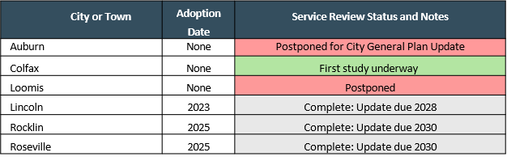

Cites Service Review Workplan
Dependent District Service Review Workplan

Slide 18
Government Code Section 56378
(a) In addition to its other powers, the commission shall initiate and make studies of existing governmental agencies. Those studies shall include, but shall not be limited to, inventorying those agencies and determining their maximum service area and service capacities. In conducting those studies, the commission may request land use information, studies, joint powers agreements, and plans of cities, counties, districts, including school districts, community college districts, joint powers agencies and joint powers authorities, regional agencies and state agencies and departments. Cities, counties, districts, including school districts, community college districts, joint powers agencies and joint powers authorities, regional agencies, and state agencies and departments, shall comply with the request of the commission for that information and the commission shall make its studies available to public agencies and any interested person. In making these studies, the commission may cooperate with the county planning commissions.
(b) The commission, or the board of supervisors on behalf of the commission, may apply for or accept, or both, any financial assistance and grants-in-aid from public or private agencies or from the state or federal government or from a local government.
Notes:
Jason

Slide 19
The last of the government mumbo jumbo
LAFCo can do a study on anything local government works on.
  These studies can even include agencies that LAFCo does not have a service review oversight role with.
LAFCo can accept outside funding to do these reports.
Notes:
Jason

Slide 20
What is the difference between
56430 (MSR) vs. 56378 (specials studies)
MSR needs to address certain criteria vs. a special study only need to address what the Commission wishes to see addressed in the report.
MSR should review an entire agency vs. special study can look at just part of an agency even just a single function of an agency.
MSR needed to change a SOI vs. special study which can not change SOI.
Notes:
Jason

Slide 21
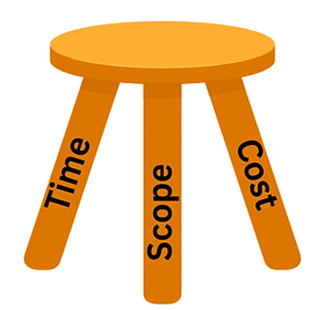
What Does Placer LAFCo Want In Its Future Service Reviews?
Should we do every agency Placer LAFCo has authority to do an MSR for even if no SOI change is needed?
Should we do these in house (when possible) vs. outside consultants?
Should we be doing these every five years for each agency vs. taking longer if needed?
How in-depth should each MSR be, if agency is doing well is a shorter MSR fine vs. show the more in depth review even if agency is doing well? (For agencies that have issues then in-depth should always be done)
Notes:
Jason

Slide 22
Next steps
Staff will review all the comments and feedback from tonight's meeting.
Staff will compile all that information and start to create a multi year work plan to present at a future meeting.
Commission will review and decide the future of service review
Notes:
Jason

Slide 23
QUESTIONS?
When the Commissioners are done with discussion and questions on the presentation staff would like the Commission thoughts on if the next MSR to be started should be the City of Loomis or if the next MSR should be Foresthill Public Utility District based on recent Grand Jury report?
Notes:
Jason

