Slide 1

April 9, 2025

Slide 2
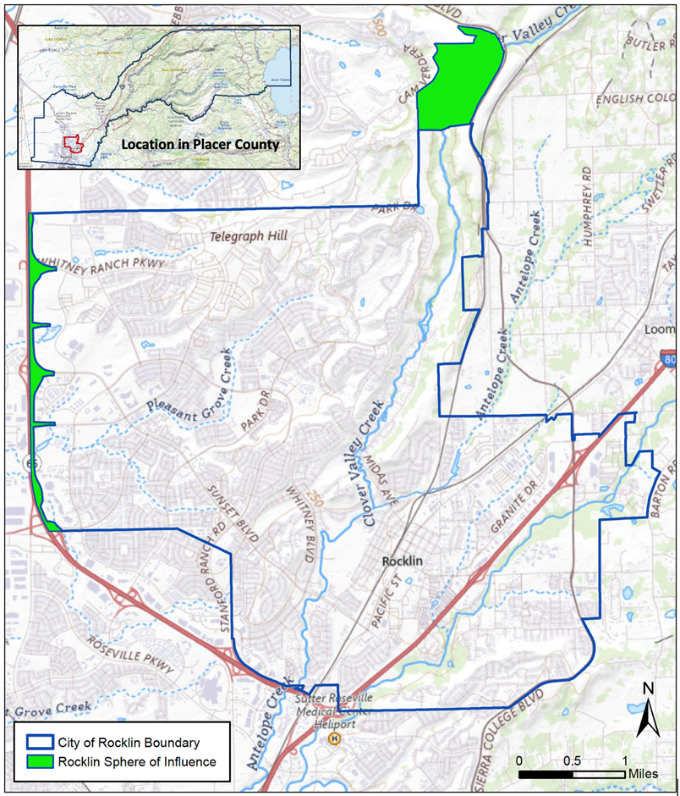
Item 6A: Rocklin Service Review and SOI Update
Draft presented on January 15, 2025.
The study circulated for 30 days, and comments were received.

Slide 3
Item 6A: Rocklin Service Review and SOI Update
Chapter 12 includes comments (verbal and written) and edits to the report.
Two key edits:
1) Removal of specific reference to SB 1383 from a study recommendation:

Slide 4
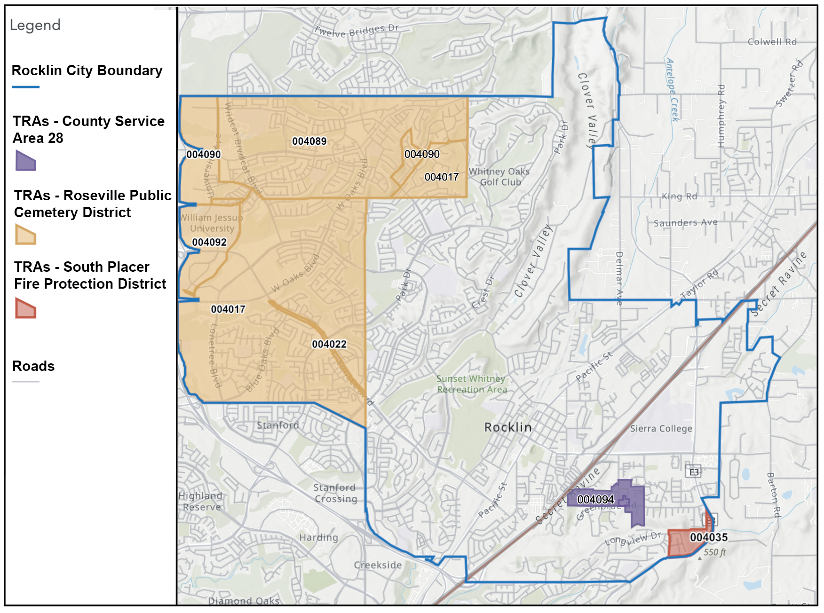
Report Edit #2
Expanded discussion of overlapping services between the City and neighboring agencies in Chapter 11, Section 11.6.

Slide 5
Item 6A: Project No. 2023-04 Service Review and Sphere of Influence Update for the City of Rocklin
Staff Recommendation:
The Executive Officer recommends that the Commission adopt proposed Resolution No. 25-04 (Attachment A), accepting the final study (Attachment B) for the City of Rocklin, making the required determinations set forth in the final study, and determining that no change to the City’s SOI is necessary.

Slide 6
Item 6B: Project No. 2022-03 Service Review
Newcastle Fire Protection District,
Penryn Fire Protection District,
Placer Hills Fire Protection District,
South Placer Fire Protection District,
City of Lincoln Fire Department,
City of Rocklin Fire Department, and
City of Roseville Fire Department.

Slide 7
Item 6B: Project No. 2022-03
On hold pending additional analysis:
Alta Fire Protection District
Foresthill Fire Protection District
City of Auburn Fire Department
City of Colfax Fire Department
Placer County Fire Department/County Service Area 28
Agencies not reviewed are mentioned occasionally in the final report to provide context or to provide a more comprehensive overview of the region.

Slide 8
Project No. 2022-03
Options identified by LAFCO’s consultant do not necessarily reflect any action that the Commission may take in the future.
The options presented in the study are illustrative in nature and do not contain the level of analysis necessary for a feasibility study (page 326 of the report, or page 735 of 930 of the packet).
SOI updates for the Fire Protection Districts are subject to additional analysis as mandated.
Reorganizations (changes to governance, services, and boundaries) are subject to additional analysis as mandated.

Slide 9
LAFCO Project No. 2022-03 Service Review of Newcastle Fire Protection District, Penryn Fire Protection District, Placer Hills Fire Protection District, and South Placer Fire Protection District and Fire Service Review for the Cities of Lincoln, Rocklin, and Roseville
The Executive Officer recommends adopting proposed Resolution No. 25-05, which accepts the final study for the Newcastle, Penryn, Placer Hills and South Placer Fire Protection Districts, as well as the Cities of Lincoln, Rocklin and Roseville for fire protection services.
In addition
LAFCO staff return with an update on the spheres of influence for the Newcastle Fire Protection District (FPD), Penryn FPD, Placer Hills FPD, and South Placer FPD.
LAFCO staff continue working on the service review study for Auburn and Colfax Fire Depts.

Slide 10
Project No. 2024-01 Service Review Study and Sphere of Influence Update – South Placer Municipal Utility District
The Executive Officer recommends that the Commission adopt proposed Resolution No. 25-06 (Attachment A), accepting the final study (Attachment B) for the South Placer Municipal Utility District, making the required determinations set forth in the final study, and determining that no change to the District’s Sphere of Influence is necessary.

Slide 11
MSR and SOI Update – Final Report
SOUTH PLACER MUNICIPAL UTILITY DISTRICT
Placer LAFCO
April 9, 2025

Slide 12
Project Timeline and Milestones
LAFCO retained RSG in June 2024 to prepare this MSR and SOI Update
July 2024: Data collection began
November 2024: Administrative Draft circulated to LAFCO and District staff
December 2024: Revised Draft circulated to LAFCO staff
January 2025: RSG presented the Administrative Draft to LAFCO Commission
February 2025: LAFCO received written comments on the draft from Placer County
March 2025: LAFCO received written comments on the draft from the District and a Revised Draft was circulated to LAFCO staff

Slide 13
Public Comments Received
The City of Lincoln provided comments during the January 15th meeting.
Since the January 15th Commission meeting, LAFCO staff and RSG have received the following public comments:
February 14th, 2025: Letter from the County of Placer
March 19th, 2025: Suggested minor changes from the South Placer Municipal Utility District

Slide 14
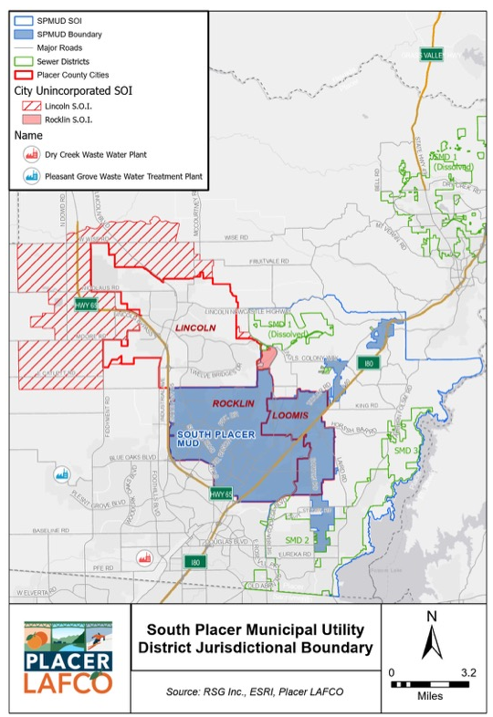
Key MSR Revisions
Included SPWA wastewater treatment plant on SPMUD Jurisdictional Boundary and SOI Map (Figure 1)
Included a map to show location of Placer County Sewer Maintenance Districts (Figure 7)
Updated maps throughout the MSR to reflect accurate SMD 1 boundaries (Figure 1 & 13)
Included additional background and history on Placer County’s Sewer Maintenance Districts (p.31)
Refined wastewater capacity and demand figures based on District comments (p. 34-36)
Included additional details regarding the District’s Out-of-Area Service Agreements based on City of Lincoln and District comments received (p.37-44)

Slide 15
Final Recommendations
In summary, RSG recommends the following:
Affirm SPMUD’s sphere of influence with the creation of a special study area for the Granite Bay Community
Approve the expansion of SPMUD’s jurisdictional boundary to include the seven (7) OAS parcels upon receipt of a completed change of organization application
Initiate discussions with the City of Lincoln and SPMUD regarding the parcel located off Creekside Lane
Conduct a MSR and SOI update for County Service Area 28 and Placer County’s Sewer Maintenance Districts 1, 2, and 3

Slide 16
Jillian Glickman, Senior Analyst
RSG
jglickman@rsgsolutions.com
714.316.2142

Slide 17
Item 6D: Proposed Workplan and Budget for Fiscal Year 2025-2026

Slide 18
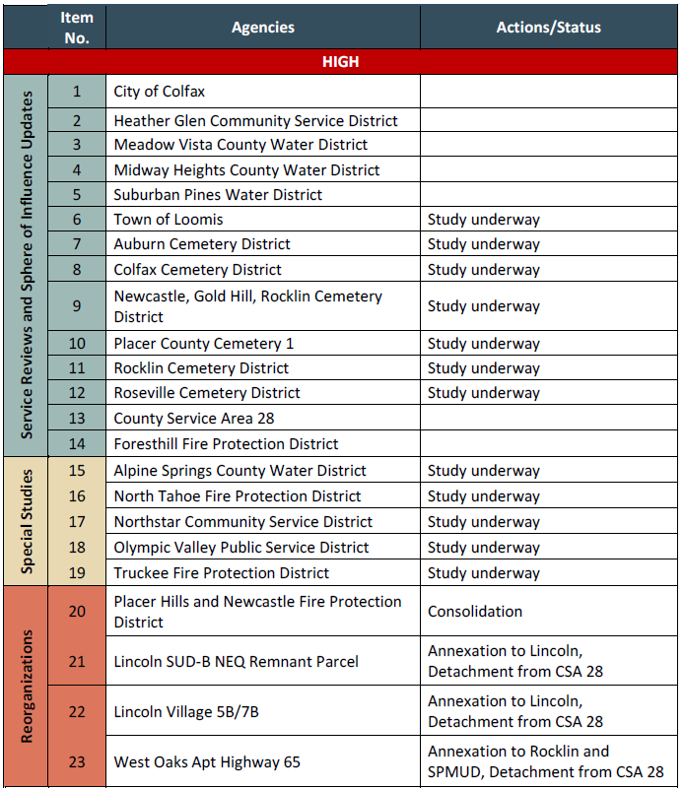
Workplan for 2025-2026 (projects 1-23)

Slide 19
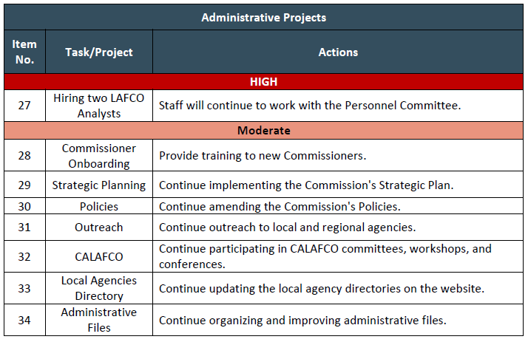
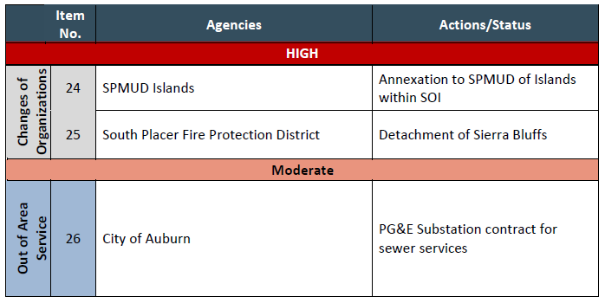
Workplan (projects 24-34)

Slide 20
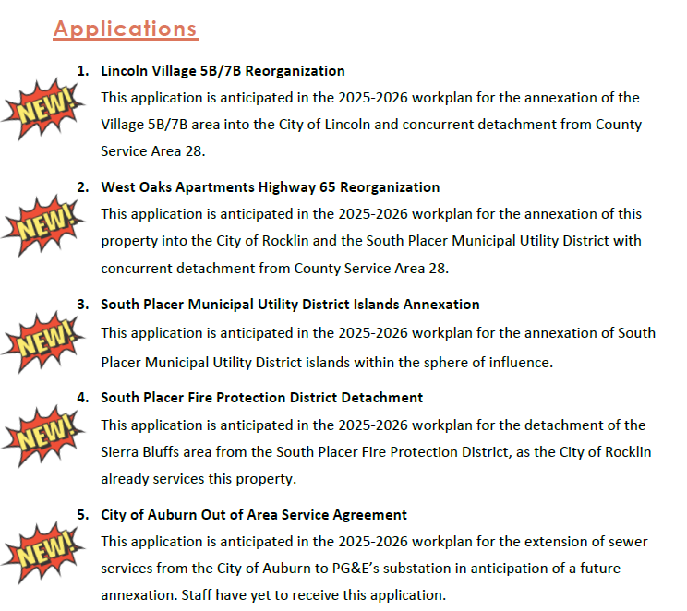
New Projects for 2025-2026

Slide 21
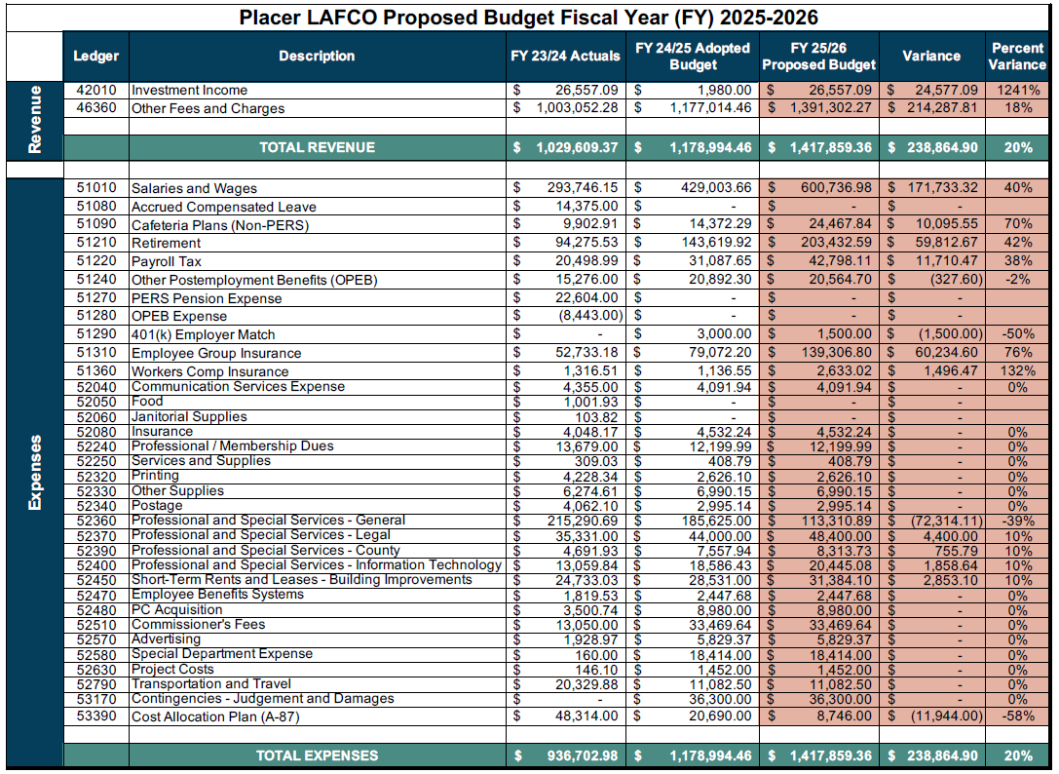

Slide 22
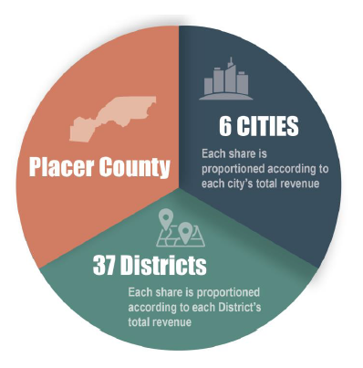
Proposed Invoice to Top 5 Funding Agencies
Agency | Prior Year Invoice | Proposed Invoice | Variance
Placer County | $392,338 | $463,767 | $71,429
City of Roseville | $286,149 | $345,541 | $59,391
PCWA | $134,898 | $149,755 | $14,857
City of Rocklin | $44,754 | $49,306 | $4,552
City of Lincoln | $45,263 | $49,021 | $3,759

Slide 23
Item 6D: Proposed Workplan and Budget for Fiscal Year 2025-2026
The Executive Officer recommends that the Commission adopt the Proposed Workplan and Budget with any desired modifications, distribute the Proposed Workplan and Budget to LAFCO’s 44 funding agencies, and return to the June 11, 2025, meeting for the Commission’s adoption of a final Workplan and Budget for FY 2025-26.

Slide 24
Upcoming LAFCO Meetings
Policy Workshop on April 22, 2025
9AM – 1PM
Holiday Inn - Auburn

Slide 25
Employee Salary & Benefits Projection

Slide 26
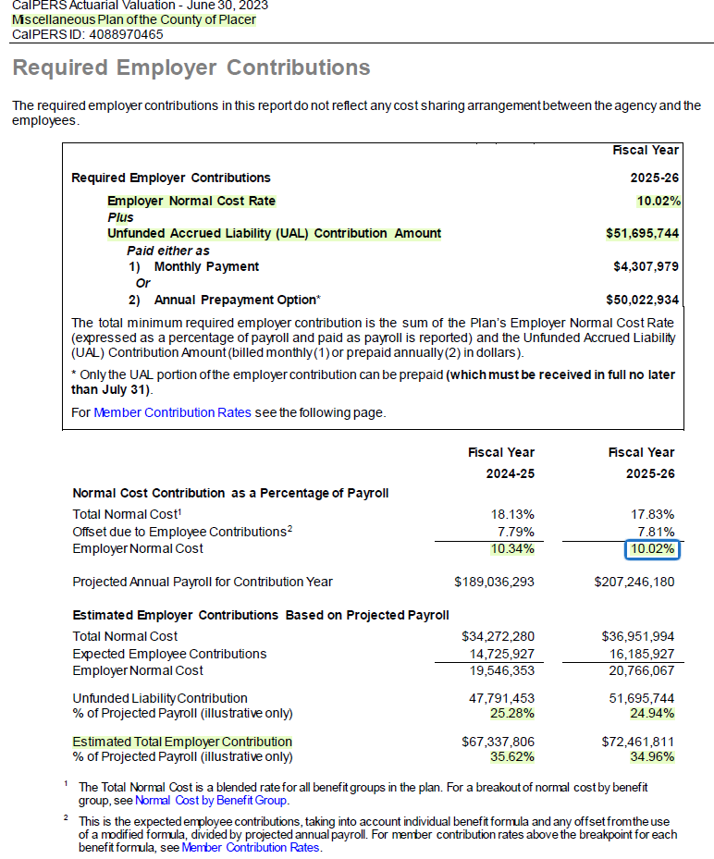
Placer County

Slide 27
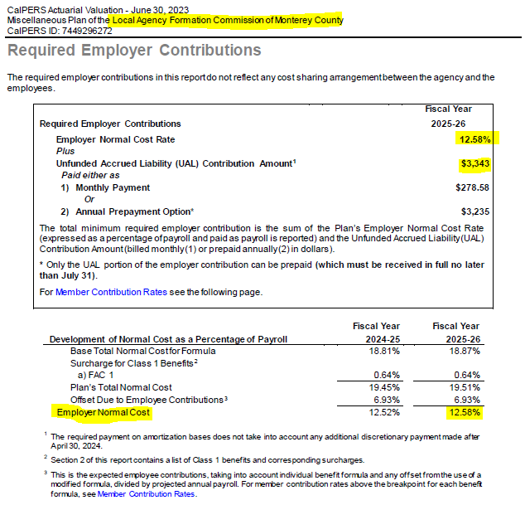
Monterey LAFCO

Slide 28
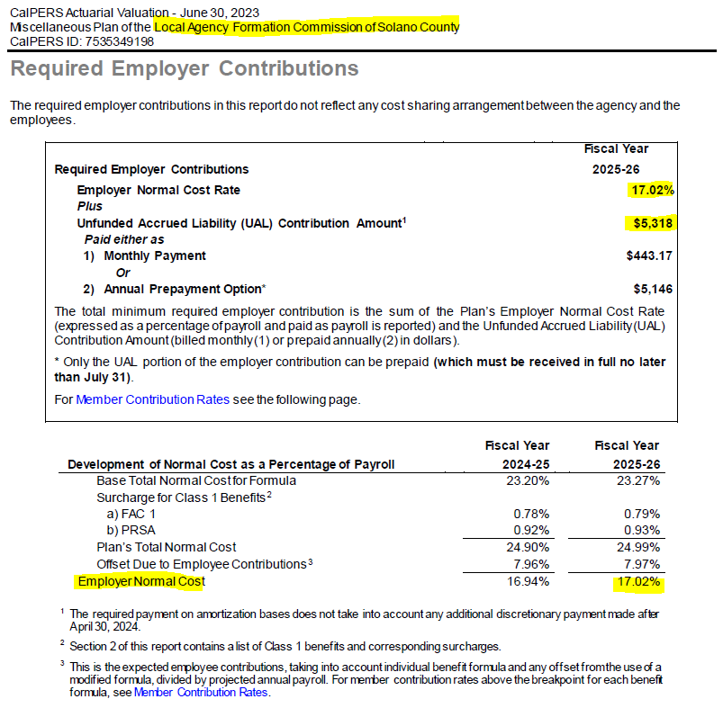
Solano LAFCO

Slide 29
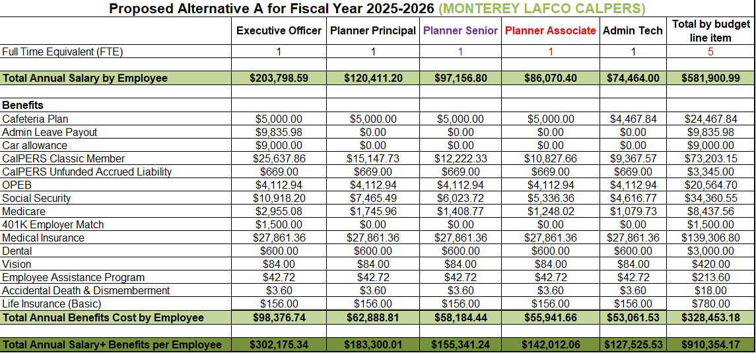
Using Monterey LAFCO’s Employer Cost
Savings of $127,000

Slide 30
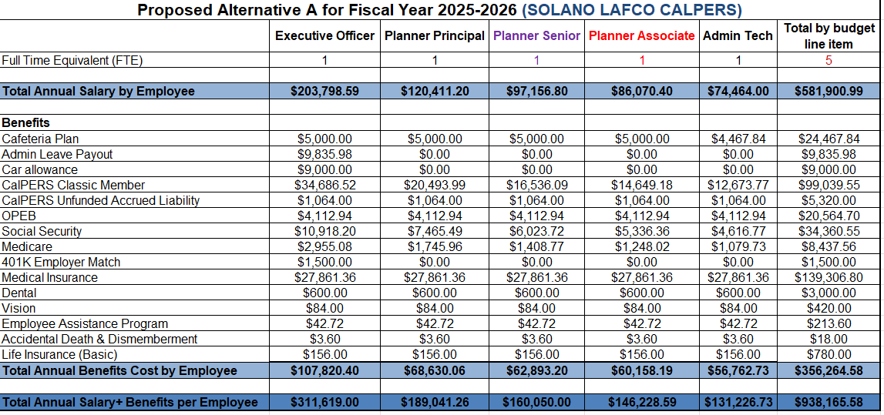
Using Solano LAFCO’s Employer Cost - PERS
Savings of $99,000

